Slide 1
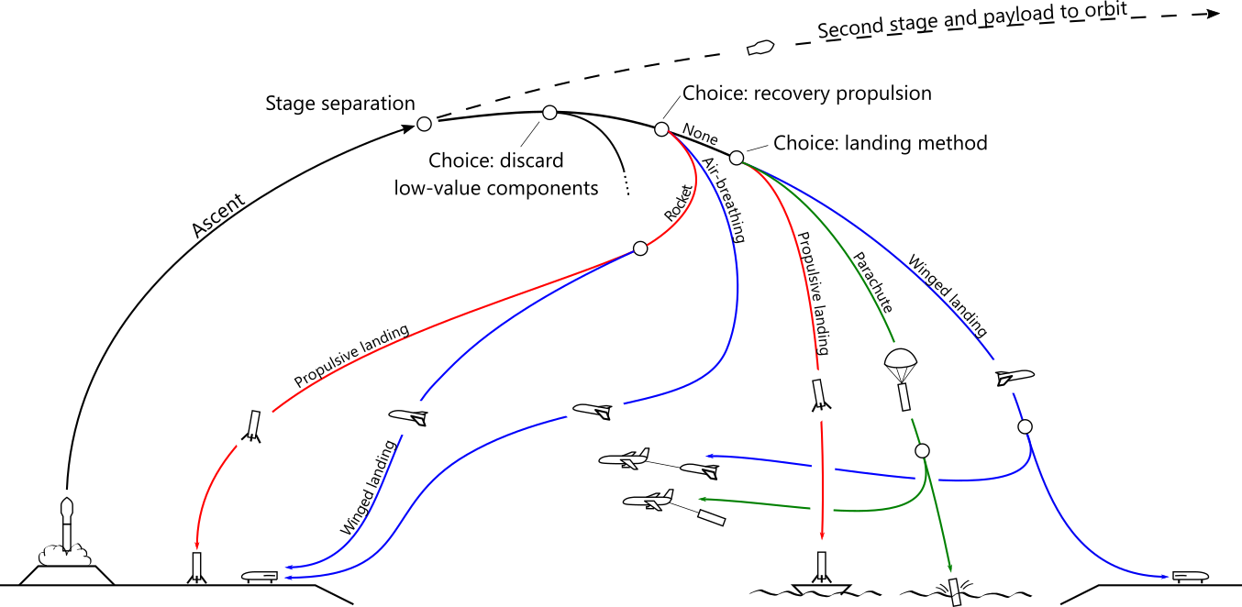
Expendable
Landing method:
Recov. prop. method:
Portion recov’d:

Slide 2
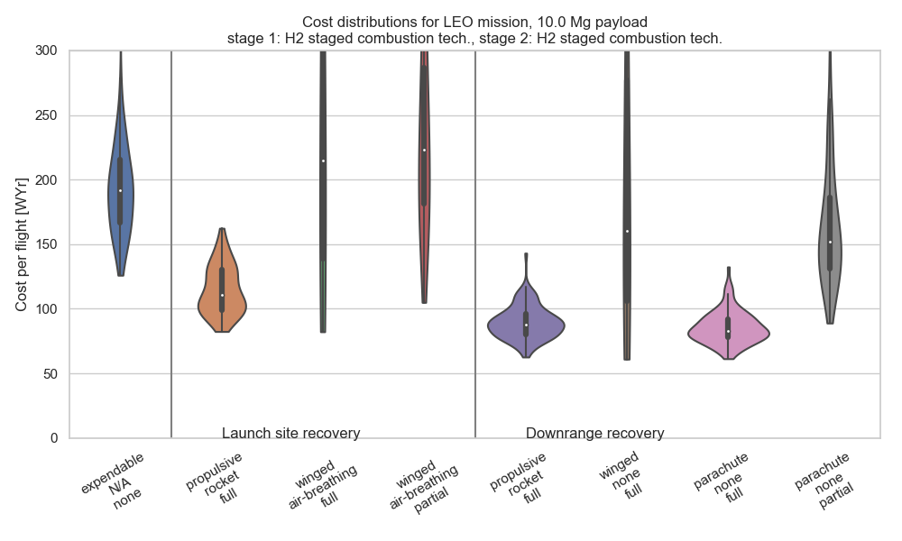
Expendable
Landing method:
Recov. prop. method:
Portion recov’d:

Slide 3
Expendable
Landing method:
Recov. prop. method:
Portion recov’d:

Slide 4
Expendable
Landing method:
Recov. prop. method:
Portion recov’d:

